Slide 1
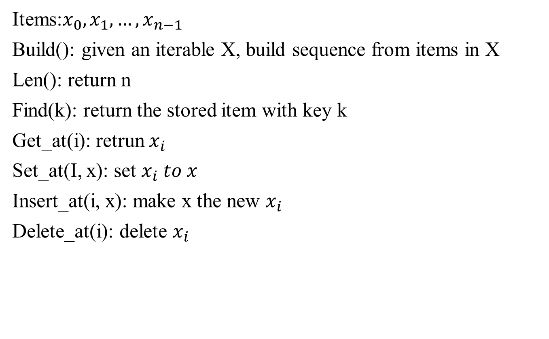
Array
Items:$x_{0}, x_{1}, …, x_{n−1}$
Build(): given an iterable X, build sequence from items in X
Len(): return n
Find(k): return the stored item with key k
Get_at(i): retrun $x_{i}$
Set_at(I, x): set $x_{i} to x$
Insert_at(i, x): make x the new $x_{i}$
Delete_at(i): delete $x_{i}$
Array
memory
 |  | $$x_{0}$$ | $$x_{1}$$ | $$x_{2}$$ | $$x_{3}$$ | … | $$x_{n−1}$$
Head

Slide 2
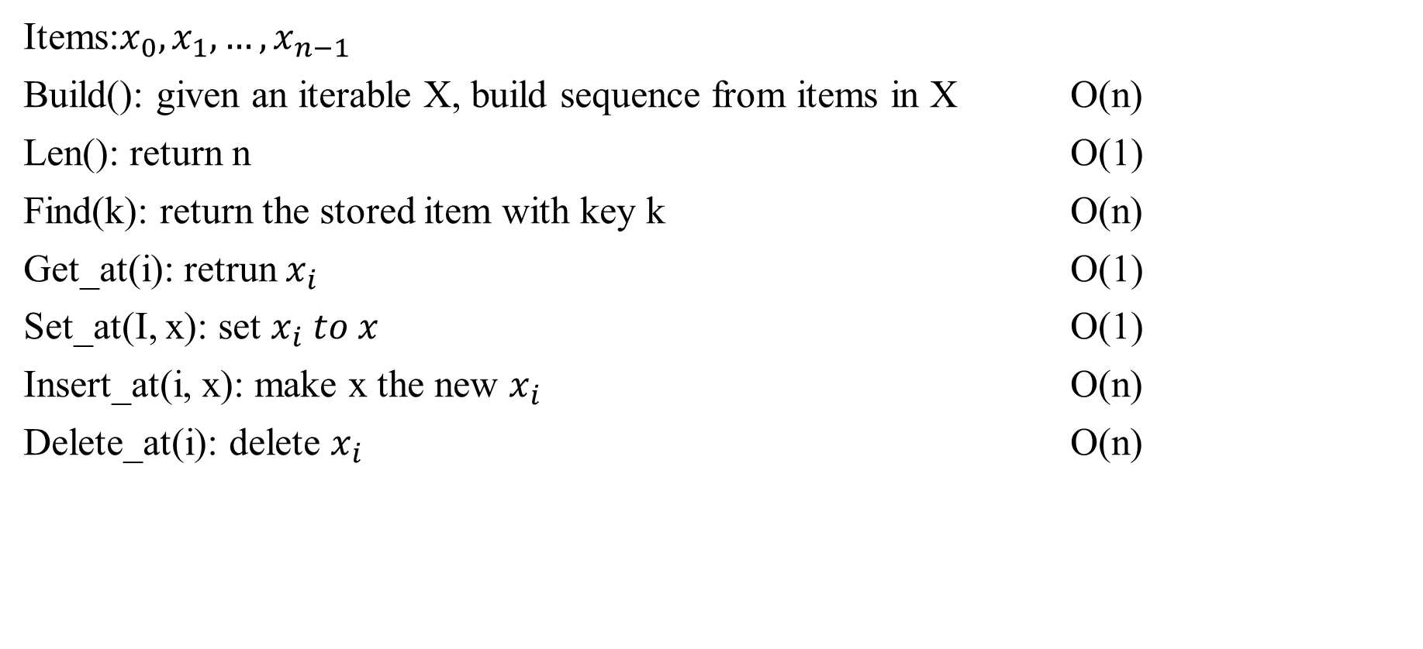
Array
Items:$x_{0}, x_{1}, …, x_{n−1}$
Build(): given an iterable X, build sequence from items in X O(n)
Len(): return n O(1)
Find(k): return the stored item with key k O(n)
Get_at(i): retrun $x_{i}$ O(1)
Set_at(I, x): set $x_{i} to x$ O(1)
Insert_at(i, x): make x the new $x_{i}$ O(n)
Delete_at(i): delete $x_{i}$ O(n)

Slide 3
Linked List
Linked List
Build(X)
Get_at(i)
Set_at(i, x)
Insert_at(i, x)
Delete_at(x)
Insert_first(x)
Delete_first()
insert_last(x)
Delete_last()
 |  | $$x_{0}$$ |  |  | $$x_{3}$$ |  |  | $$x_{2}$$
Head
memory

Slide 4
Linked list
Build(X) O(n)
Get_at(i) O(n)
Set_at(i, x) O(n)
Insert_at(i, x) O(n)
Delete_at(x) O(n)
Insert_first(x) O(1)
Delete_first() O(1)
insert_last(x) O(n)
Delete_last() O(n)

Slide 5


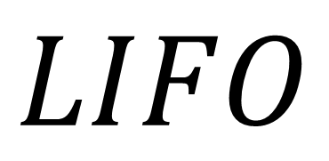

Stack
push(value)
Pop()
Top()
isEmpty()
$$pop$$
$$push$$
9
$$top$$
4
2
5
$$LIFO$$
7
3

Slide 6

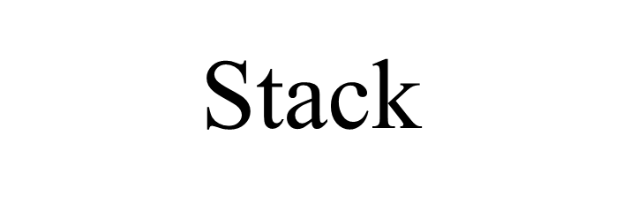
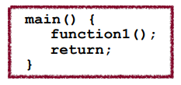
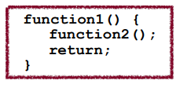
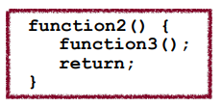
Let’s say we had a program like this:
What happens to the state of the system as this program runs?

Slide 7
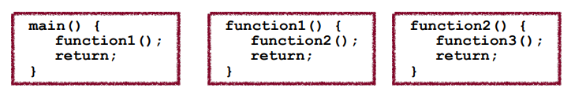
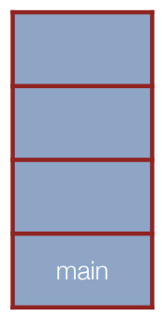

Slide 8
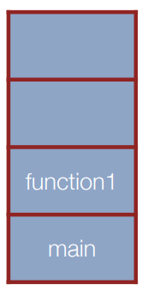

Slide 9
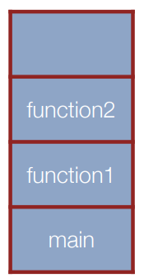

Slide 10
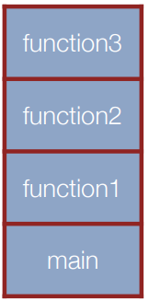

Slide 11
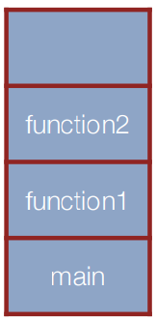

Slide 12
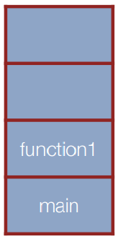

Slide 13
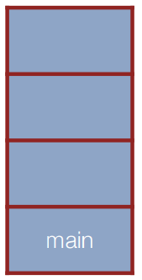

Slide 14

Advanced Stack Example
$$5∗4−8 /2+9$$
Use “postfit” notation

Slide 15
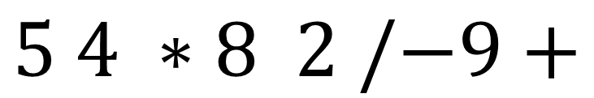
Advanced Stack Example
$$5∗4−8 /2+9$$
Use “postfit” notation
$$5 4 ∗8 2 /−9+$$

Slide 16
Advanced Stack Example
$$5∗4−8 /2+9$$
Use “postfit” notation
$$5 4 ∗8 2 /−9+$$

Slide 17









Advanced Stack Example
$$5$$
$$4$$
$$5∗4−8 /2+9$$
$$∗$$
$$8$$
Use “postfit” notation
$$2$$
$$/$$
$$5 4 ∗8 2 /−9+$$
$$−$$
$$9$$
$$+$$

Slide 18

Advanced Stack Example
$$5∗4−8 /2+9$$
$$5∗4$$
20
$$8$$
Use “postfit” notation
$$2$$
$$/$$
$$5 4 ∗8 2 /−9+$$
$$−$$
$$9$$
$$+$$

Slide 19


Advanced Stack Example
$$5∗4−8 /2+9$$
Use “postfit” notation
$$5∗4$$
20
$$8 /2$$
4
$$5 4 ∗8 2 /−9+$$
$$−$$
$$9$$
$$+$$

Slide 20

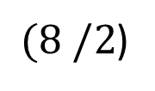

Advanced Stack Example
$$5∗4−8 /2+9$$
Use “postfit” notation
$$5 4 ∗8 2 /−9+$$
$$(5∗4)$$
$$−$$
$(8 /2$)
16
$$9$$
$$+$$

Slide 21

Advanced Stack Example
$$5∗4−8 /2+9$$
Use “postfit” notation
$$5 4 ∗8 2 /−9+$$
$$\left(5∗5\right)−\left(8 \backslash 2\right)+9$$
25

Slide 22

Queue
enqueue(value) (or add(value))
dequeue() (or remove())
front() (or peek())
isEmpty()

Slide 23
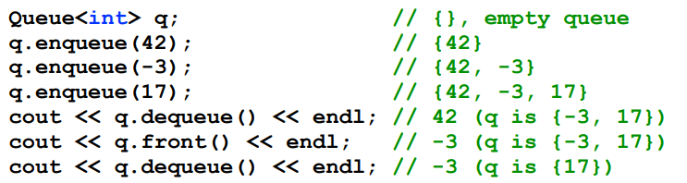
Queue
enqueue(value) (or add(value))
dequeue() (or remove())
front() (or peek())
isEmpty()

Slide 24
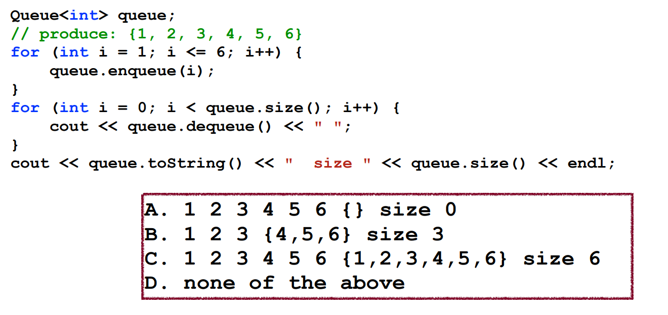
Queue Mystery
What is the output of the following code?

Slide 25
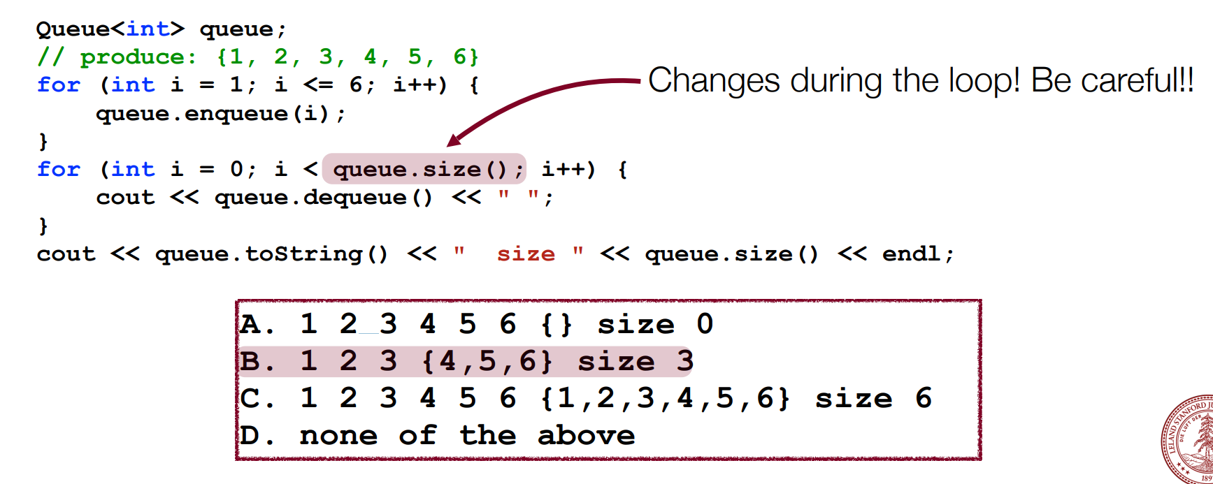
Queue Mystery
What is the output of the following code?

